Slide 1
Chapter 22 Elementary Graph Algorithms Part II
Chi-Yeh Chen
陳奇業
成功大學資訊工程學系

Slide 2
Topological sort

Slide 3
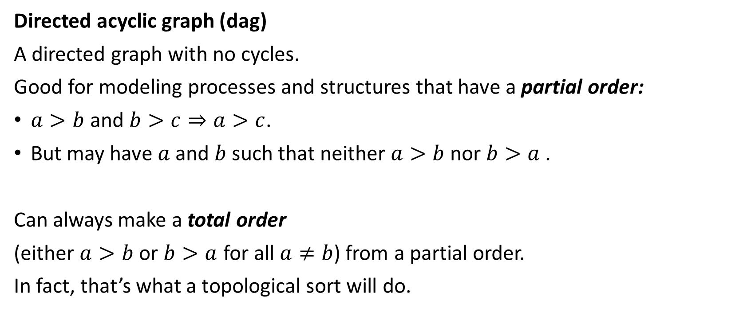
Topological sort
Directed acyclic graph (dag)
A directed graph with no cycles.
Good for modeling processes and structures that have a partial order:
$a>b$ and $b>c⇒a>c$.
But may have $a$ and $b$ such that neither $a>b$ nor $b>a$ .
Can always make a total order
(either $a>b$ or $b>a$ for all $a≠b$) from a partial order.
In fact, that’s what a topological sort will do.

Slide 4


Topological sort
Define： A topological sort of a dag $G=(V,E)$ is a linear ordering of all its vertices such that if $G$ contains an edge $(u,v)$, then $u$ appears before $v$ in the ordering

Slide 6

Don’t need to sort by finish times.
Can just output vertices as they’re finished and understand that we want the reverse of this list.
Or put them onto the front of a linked list as they’re finished. When done, the list contains vertices in topological sorted order.
Time: $Θ\left(V+E\right)$

Slide 7
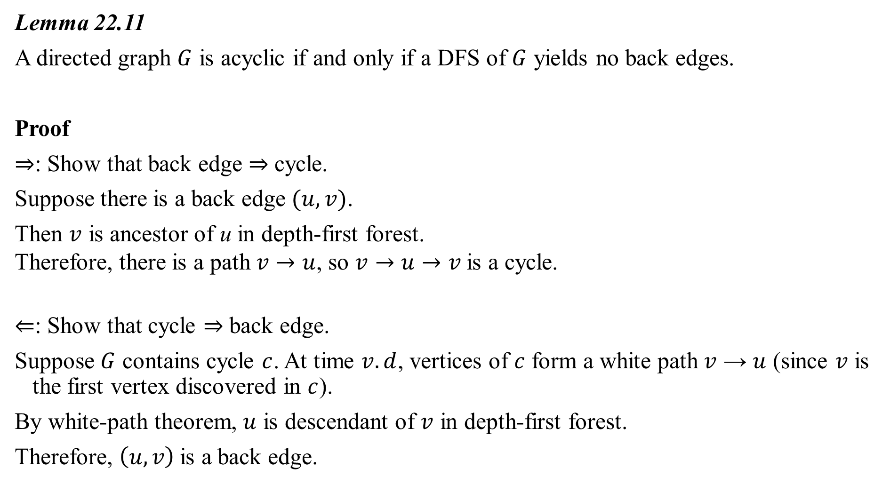
Lemma 22.11
A directed graph $G$ is acyclic if and only if a DFS of $G$ yields no back edges.
Proof
$⇒$: Show that back edge $⇒$ cycle.
Suppose there is a back edge $(u,v)$.
Then $v$ is ancestor of u in depth-first forest.
Therefore, there is a path $v→u$, so $v→u→v$is a cycle.
$⇐$: Show that cycle $⇒$ back edge.
Suppose $G$ contains cycle $c$. At time $v.d$, vertices of $c$ form a white path $v$ → $u$ (since $v$ is the first vertex discovered in $c$).
By white-path theorem, $u$ is descendant of $v$ in depth-first forest.
Therefore, $\left(u,v\right)$is a back edge.

Slide 8
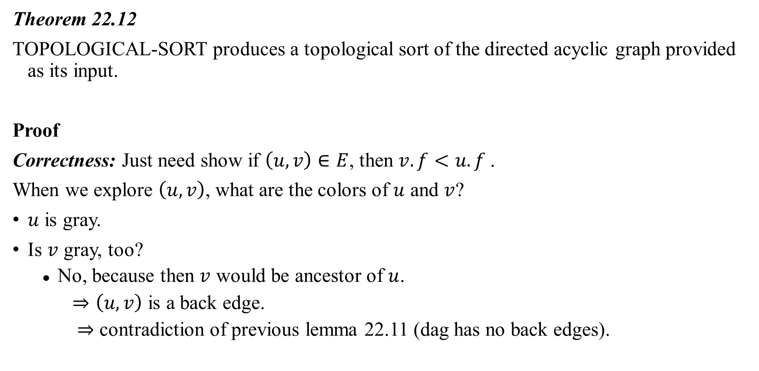
Theorem 22.12
TOPOLOGICAL-SORT produces a topological sort of the directed acyclic graph provided as its input.
Proof
Correctness: Just need show if $\left(u,v\right)∈E$, then $v.f<u.f$.
When we explore $\left(u,v\right)$, what are the colors of $u$ and $v$?
$u$ is gray.
Is $v$ gray, too?
No, because then $v$ would be ancestor of $u$.
$⇒\left(u,v\right)$ is a back edge.
$⇒$ contradiction of previous lemma 22.11 (dag has no back edges).

Slide 9
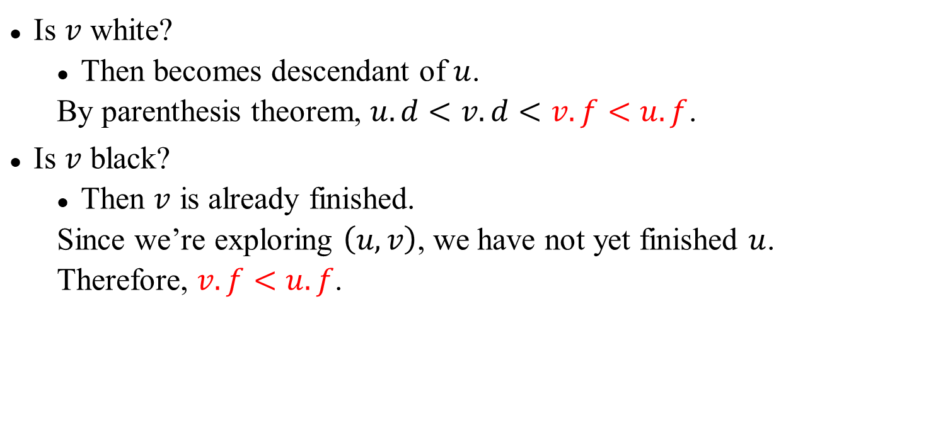
Is $v$ white?
Then becomes descendant of $u$.
By parenthesis theorem, $u.d<v.d<v.f<u.f$.
Is $v$ black?
Then $v$ is already finished.
Since we’re exploring $\left(u,v\right)$, we have not yet finished $u$.
Therefore, $v.f<u.f$.

Slide 10
Strongly connected components

Slide 11
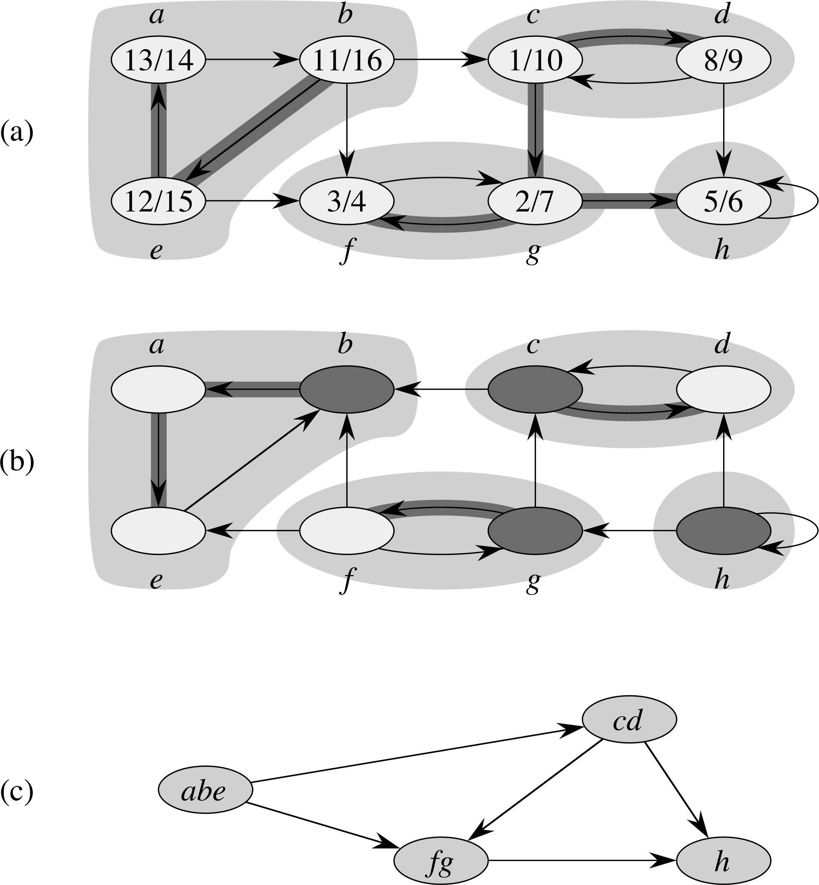

Strongly connected components
Given directed graph $G=(V,E)$ .
A strongly connected component (SCC) of $G$ is a
maximal set of vertices $C⊆V$ such that for all $u,v∈C$, both $u→v$ and $v→u$.
Example: [Just show SCC’s at first. Do DFS a little later.]

Slide 12
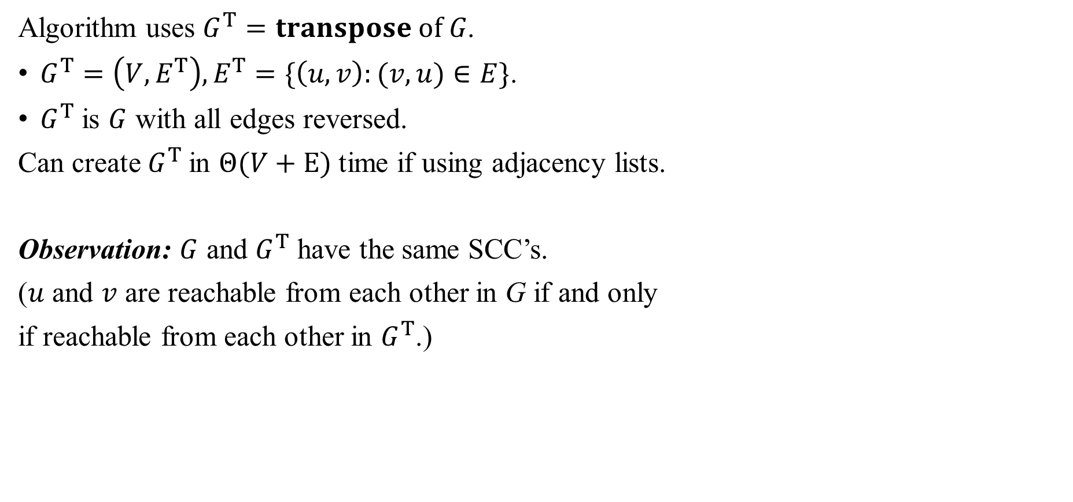
Algorithm uses $G^{T}=transpose of G$.
$G^{T}=\left(V,E^{T}\right),E^{T}=\{\left(u,v\right):(v,u)∈E\}$.
$G^{T}$ is $G$ with all edges reversed.
Can create $G^{T}$in $Θ(V+E)$ time if using adjacency lists.
Observation: $G$ and $G^{T}$ have the same SCC’s.
($u$ and $v$ are reachable from each other in G if and only
if reachable from each other in $G^{T}$.)

Slide 13

Component graph
$G^{SCC}={(V}^{SCC},E^{SCC})$.
$V^{SCC}$has one vertex for each SCC in $G$.
$E^{SCC}$ has an edge if there’s an edge between the corresponding SCC’s in $G$.
For our example:

Slide 15
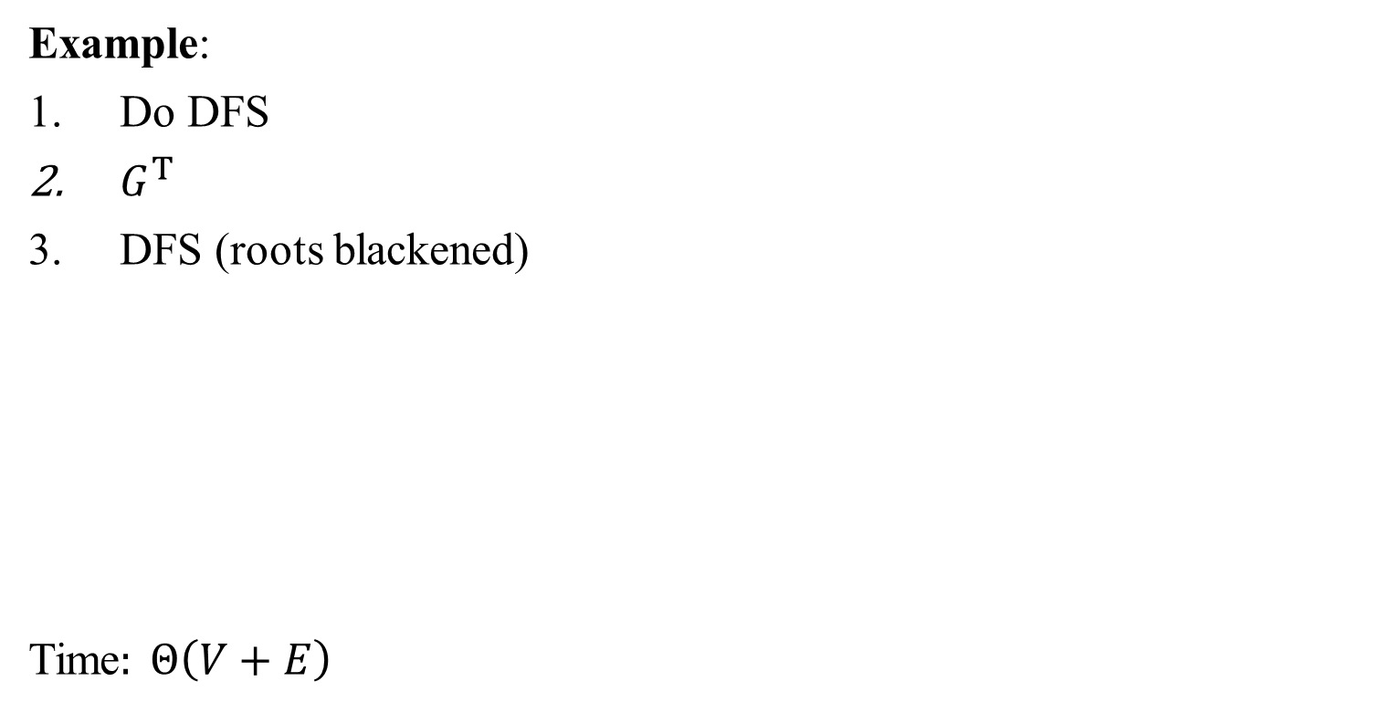
Example:
Do DFS
$G^{T}$
DFS (roots blackened)
Time$: Θ\left(V+E\right)$
14/19
15/16
3/4
1/12
6/9
17/18
13/20
2/5
10/11
7/8

Slide 16



14/
C
B
14/19
15/16
15/
3/
3/4
1/
1/12
6/
6/9
B
B
F
17/
13/
2/
10/11
2/5
10/
7/
17/18
13/20
7/8
B
C
C
3/
3/4
6/
6/7
10/
10/13
9/
9/14
17/
17/20
$$G^{T}$$
2/
15/16
2/5
1/
1/8
11/12
11/
15/
18/19
18/

Slide 17
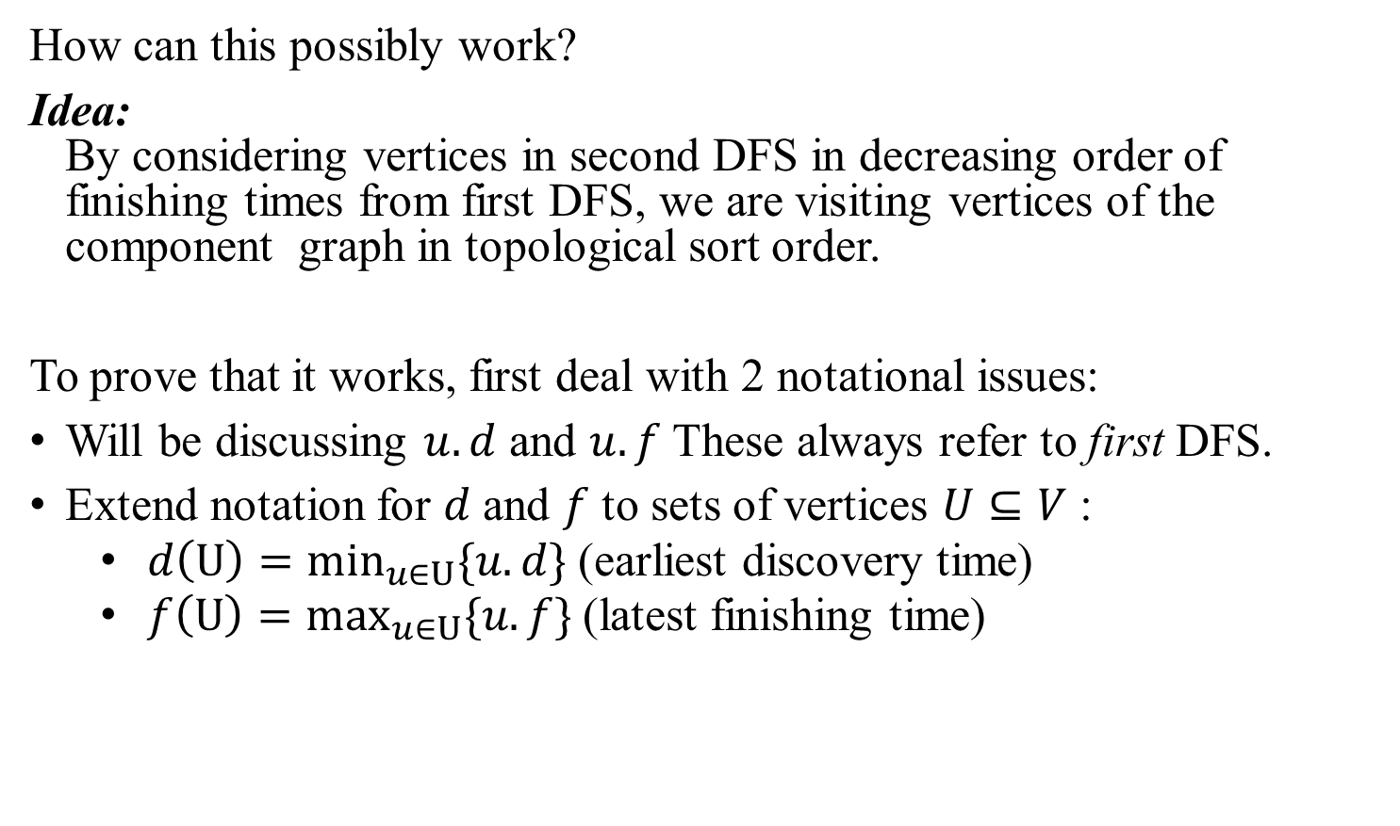
How can this possibly work?
Idea: By considering vertices in second DFS in decreasing order of finishing times from first DFS, we are visiting vertices of the component graph in topological sort order.
To prove that it works, first deal with 2 notational issues:
Will be discussing $u.d$ and $u.f$ These always refer to first DFS.
Extend notation for $d$ and $f$ to sets of vertices $U⊆V$ :
$d\left(U\right)=\min_{u∈U}\{u.d\}$(earliest discovery time)
$f\left(U\right)=\max_{u∈U}\{u.f\}$(latest finishing time)

Slide 18
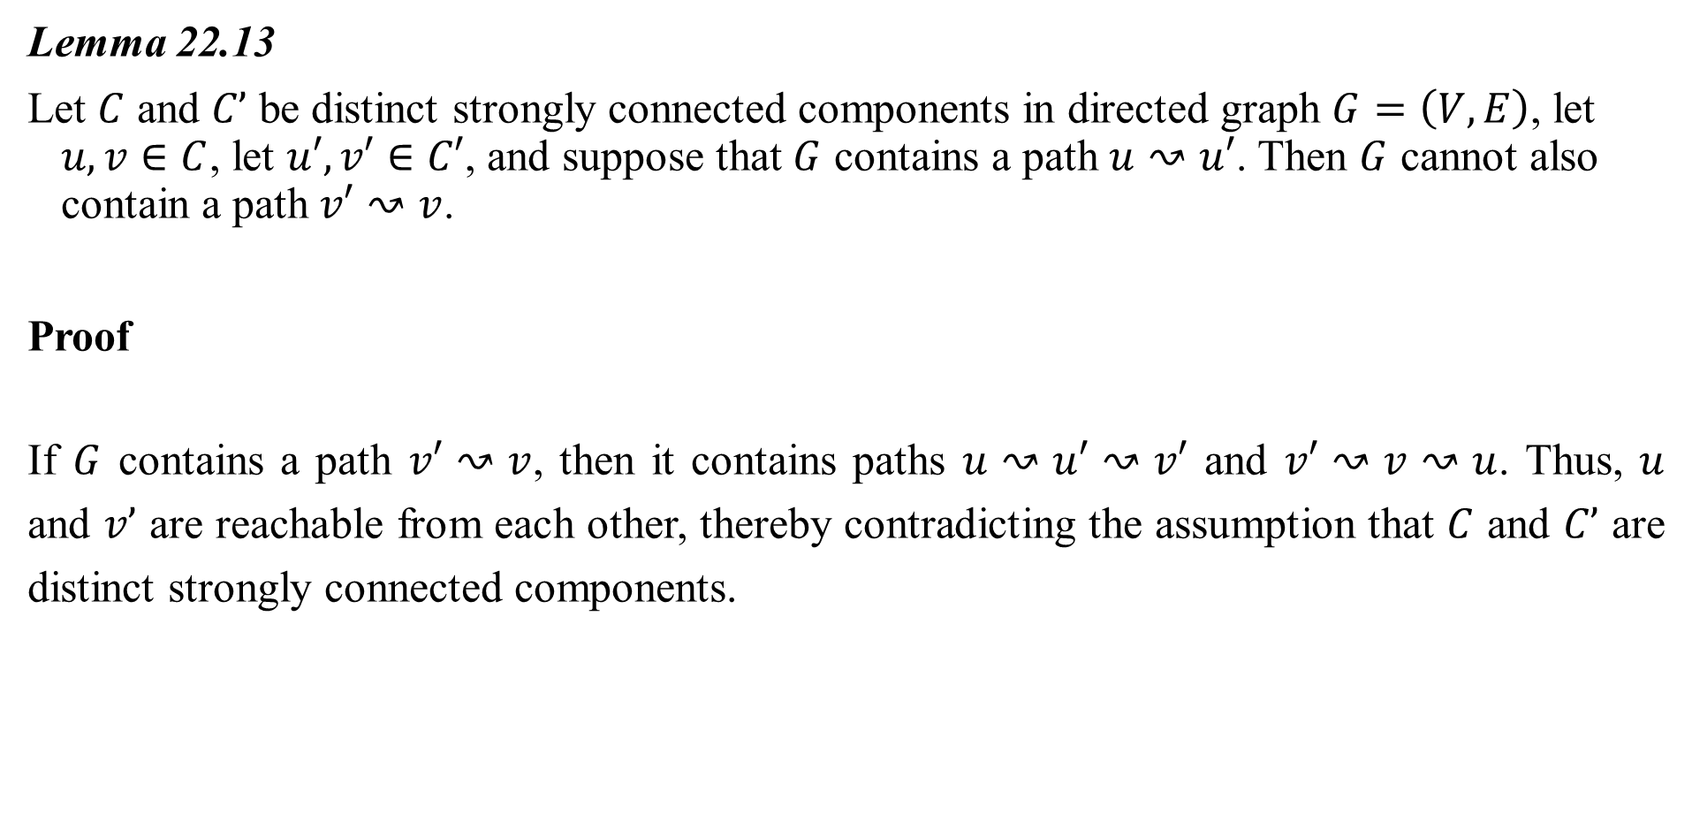
Lemma 22.13
Let $C$ and $C’$ be distinct strongly connected components in directed graph $G=\left(V, E\right)$, let $u,v∈C$, let $u′,v′∈C′$, and suppose that $G$ contains a path $u↝u′$. Then $G$ cannot also contain a path $v′↝v$.
Proof
If $G$ contains a path $v′↝v$, then it contains paths $u↝u′↝v′$ and $v′↝v↝u$. Thus, $u$ and $v’$ are reachable from each other, thereby contradicting the assumption that $C$ and $C’$ are distinct strongly connected components.

Slide 19
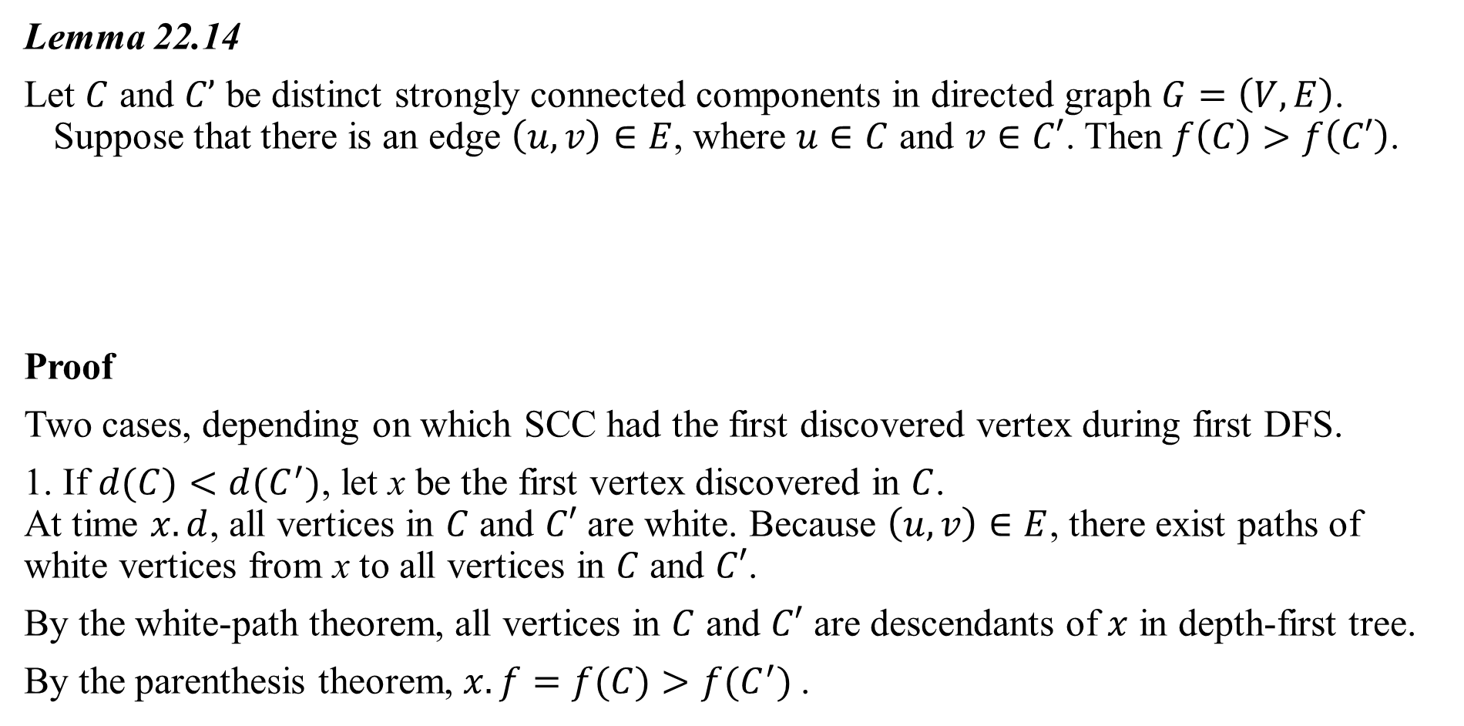
Lemma 22.14
Let $C$ and $C’$ be distinct strongly connected components in directed graph $G=\left(V, E\right)$. Suppose that there is an edge $\left(u, v\right)∈E$, where $u∈C$ and $v∈C′$. Then $f\left(C\right)>f\left(C′\right)$.
Proof
Two cases, depending on which SCC had the first discovered vertex during first DFS.
1. If $d(C)<d(C^{′})$, let x be the first vertex discovered in $C$. At time $x.d$, all vertices in $C$ and $C′$ are white. Because $\left(u, v\right)∈E$, there exist paths of white vertices from x to all vertices in $C$ and $C′$.
By the white-path theorem, all vertices in $C$ and $C′$ are descendants of $x$ in depth-first tree.
By the parenthesis theorem, $x.f=f(C)>f(C^{′})$.
C
C’
u
v

Slide 20
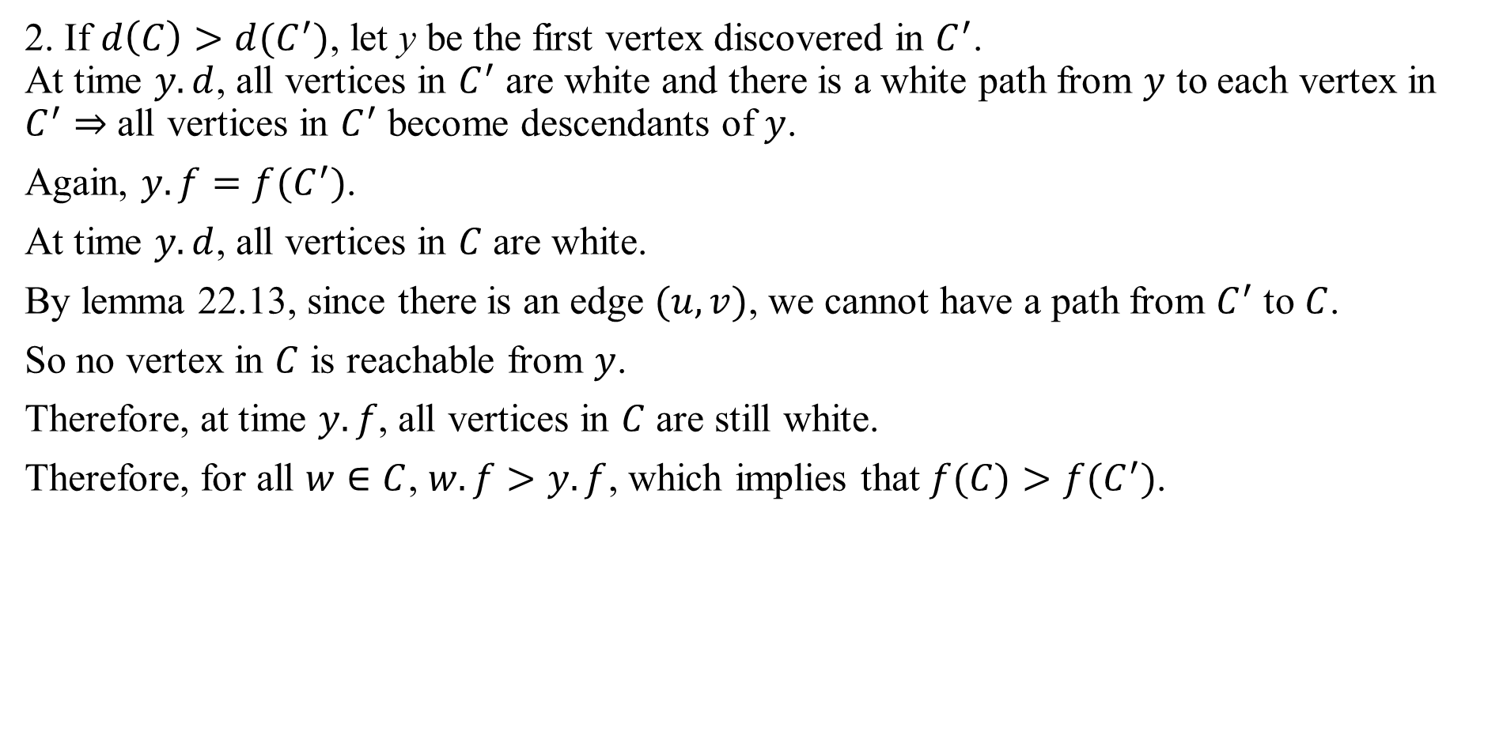
2. If $d\left(C\right)>d(C^{′})$, let y be the first vertex discovered in $C^{′}$. At time $y.d$, all vertices in $C^{′}$ are white and there is a white path from $y$ to each vertex in $C^{′}⇒$ all vertices in $C^{′}$ become descendants of $y$.
Again, $y.f=f(C^{′})$.
At time $y.d$, all vertices in $C$ are white.
By lemma 22.13, since there is an edge $(u,v)$, we cannot have a path from $C^{′}$ to $C$.
So no vertex in $C$ is reachable from $y$.
Therefore, at time $y.f$, all vertices in $C$ are still white.
Therefore, for all $w∈C$, $w.f>y.f$, which implies that $f(C)>f(C^{′})$.

Slide 21
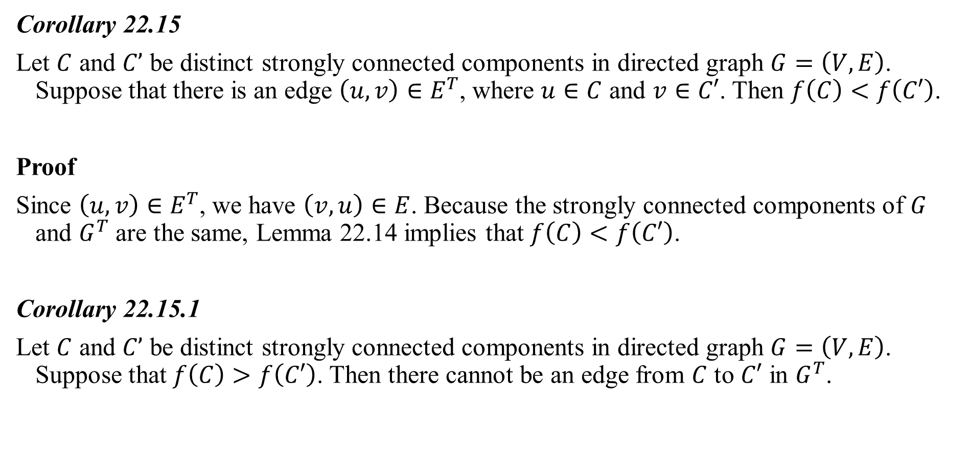
Corollary 22.15
Let $C$ and $C’$ be distinct strongly connected components in directed graph $G=\left(V, E\right)$. Suppose that there is an edge $\left(u, v\right)∈E^{T}$, where $u∈C$ and $v∈C′$. Then $f\left(C\right)<f\left(C′\right)$.
Proof
Since $\left(u, v\right)∈E^{T}$, we have $\left(v, u\right)∈E$. Because the strongly connected components of $G$ and $G^{T}$ are the same, Lemma 22.14 implies that $f\left(C\right)<f\left(C′\right)$.
Corollary 22.15.1
Let $C$ and $C’$ be distinct strongly connected components in directed graph $G=\left(V, E\right)$. Suppose that $f\left(C\right)>f\left(C′\right)$. Then there cannot be an edge from $C$ to $C′$ in $G^{T}$.

Slide 22
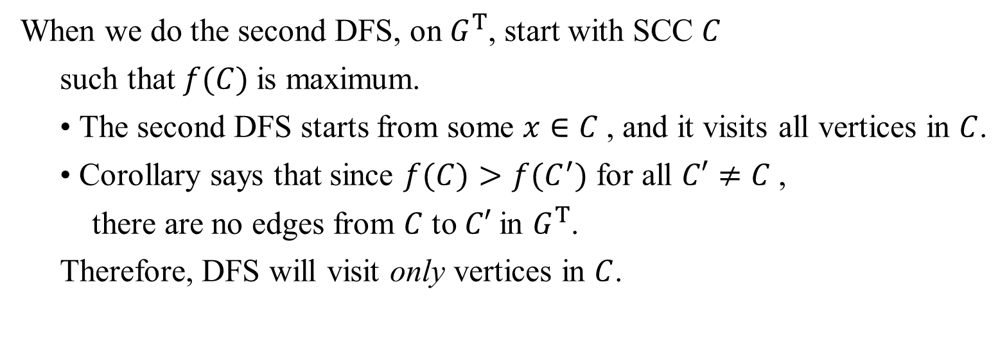
Why the SCC procedure works:
When we do the second DFS, on $G^{T}$, start with SCC $C$
such that $f(C)$is maximum.
• The second DFS starts from some $x∈C$, and it visits all vertices in $C$.
• Corollary says that since $f(C)>f(C^{′})$ for all $C′≠C$,
there are no edges from $C$ to $C′$in $G^{T}$.
Therefore, DFS will visit only vertices in $C$.

Slide 23
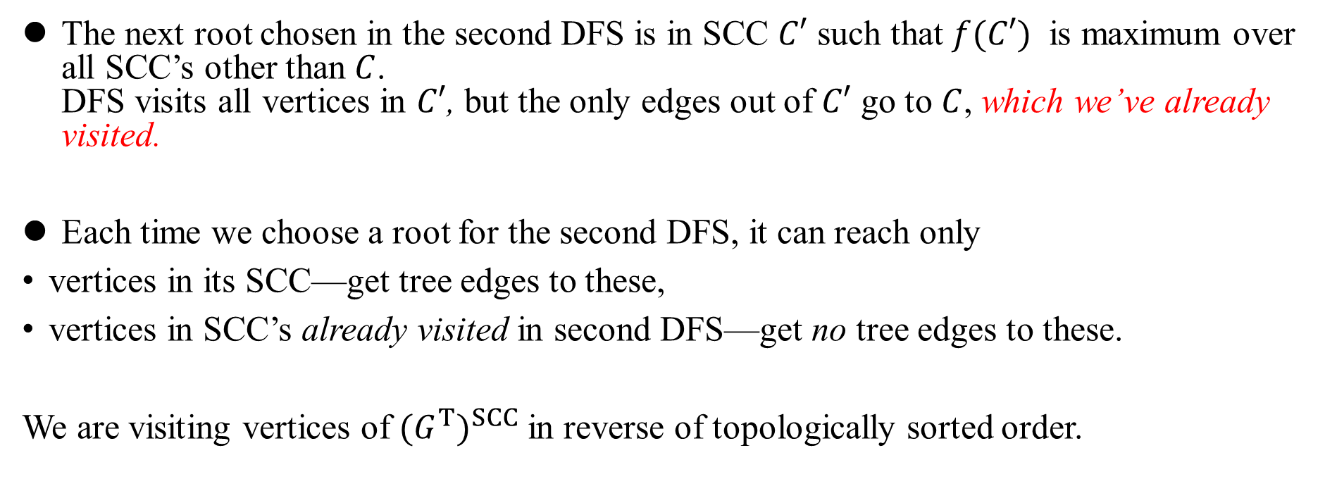
The next root chosen in the second DFS is in SCC $C′$ such that $f(C′)$ is maximum over all SCC’s other than $C$. DFS visits all vertices in $C′$, but the only edges out of $C′$ go to $C$, which we’ve already visited.
Each time we choose a root for the second DFS, it can reach only
vertices in its SCC—get tree edges to these,
vertices in SCC’s already visited in second DFS—get no tree edges to these.
We are visiting vertices of ${(G^{T})}^{SCC}$ in reverse of topologically sorted order.

Slide 24
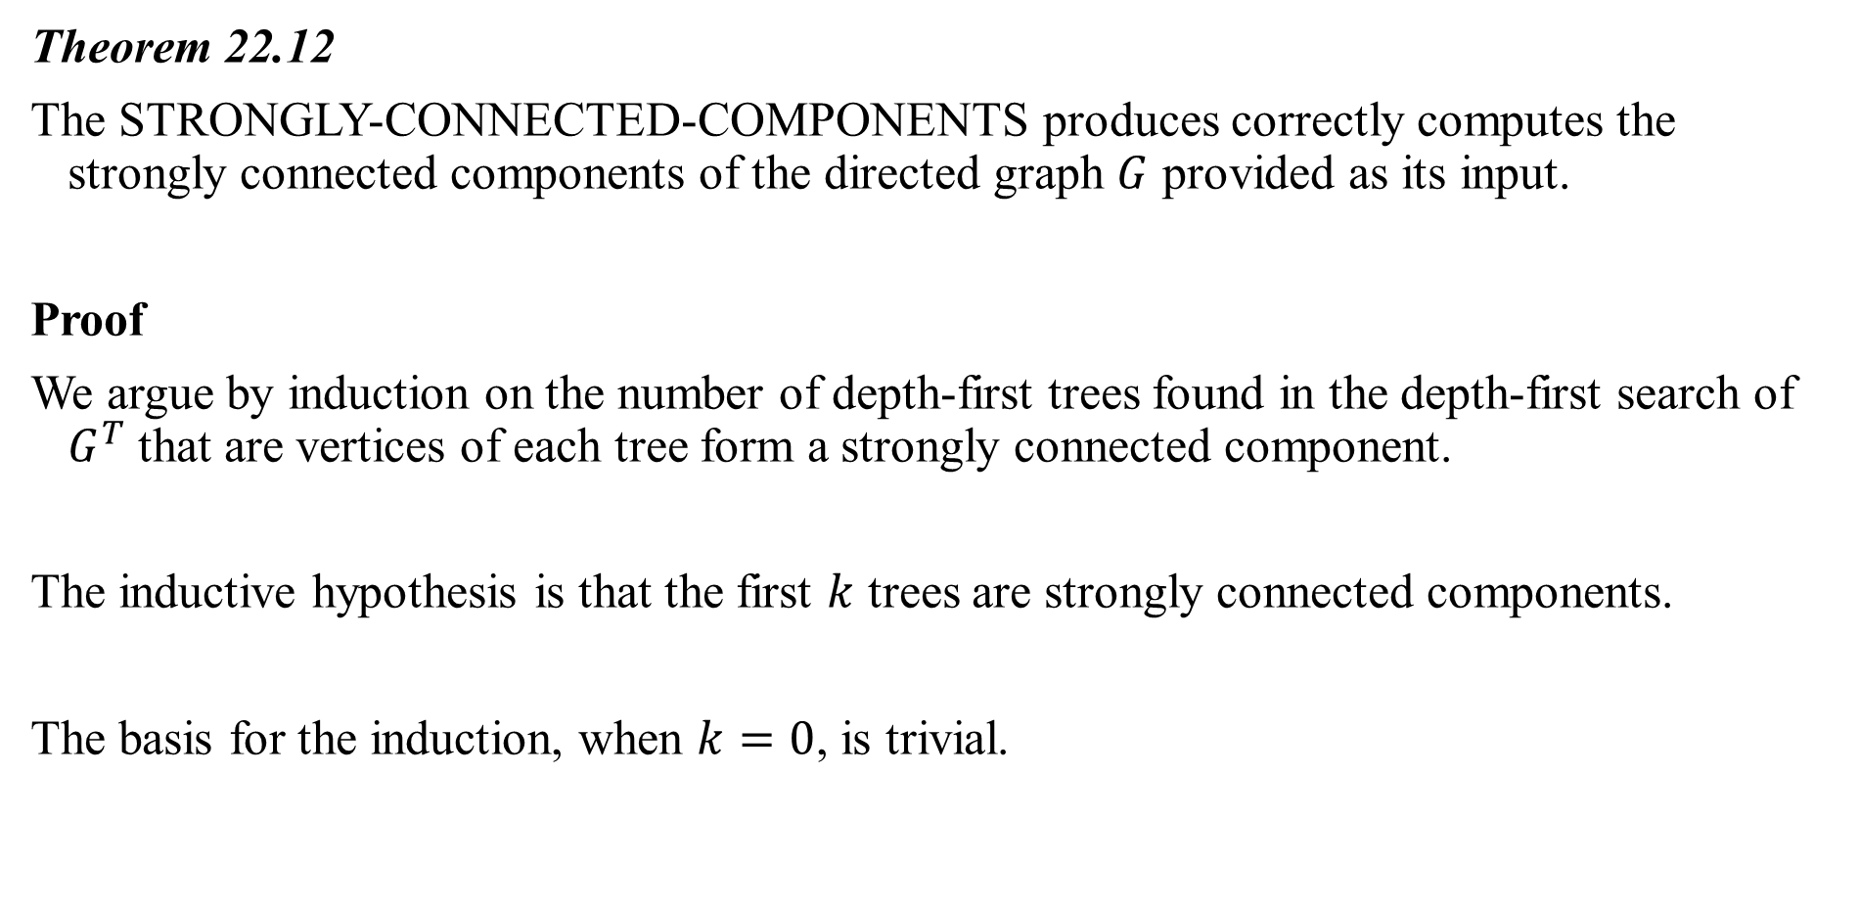
Theorem 22.12
The STRONGLY-CONNECTED-COMPONENTS produces correctly computes the strongly connected components of the directed graph $G$ provided as its input.
Proof
We argue by induction on the number of depth-first trees found in the depth-first search of $G^{T}$ that are vertices of each tree form a strongly connected component.
The inductive hypothesis is that the first $k$ trees are strongly connected components.
The basis for the induction, when $k=0$, is trivial.

Slide 25
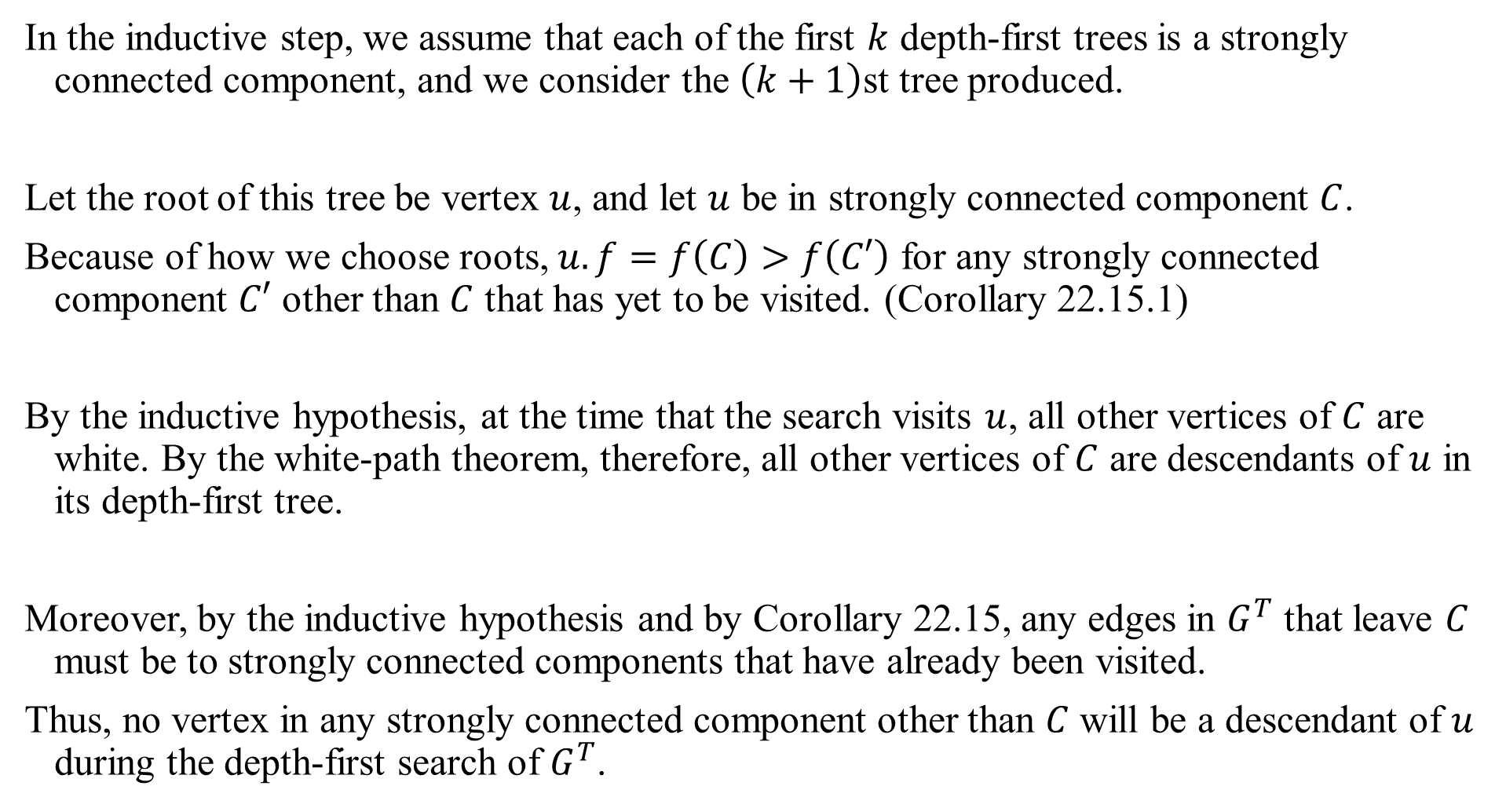
In the inductive step, we assume that each of the first $k$ depth-first trees is a strongly connected component, and we consider the $\left(k+1\right)$st tree produced.
Let the root of this tree be vertex $u$, and let $u$ be in strongly connected component $C$.
Because of how we choose roots, $u.f=f\left(C\right)>f\left(C′\right)$ for any strongly connected component $C′$ other than $C$ that has yet to be visited. (Corollary 22.15.1)
By the inductive hypothesis, at the time that the search visits $u$, all other vertices of $C$ are white. By the white-path theorem, therefore, all other vertices of $C$ are descendants of $u$ in its depth-first tree.
Moreover, by the inductive hypothesis and by Corollary 22.15, any edges in $G^{T}$ that leave $C$ must be to strongly connected components that have already been visited.
Thus, no vertex in any strongly connected component other than $C$ will be a descendant of $u$ during the depth-first search of $G^{T}$.

Slide 26

Thus, the vertices of the depth-first tree in $G^{T}$ that is rooted at $u$ form exactly one strongly connected component, which completes the inductive step and the proof.

